Slide 1
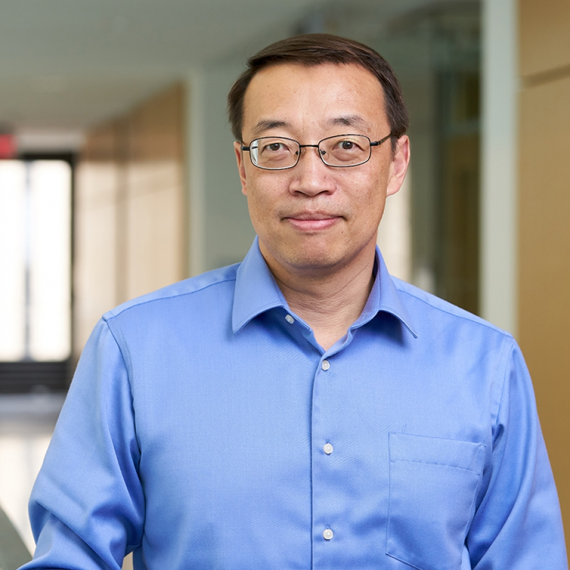
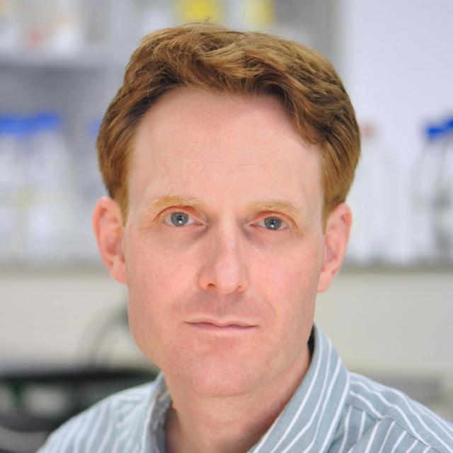
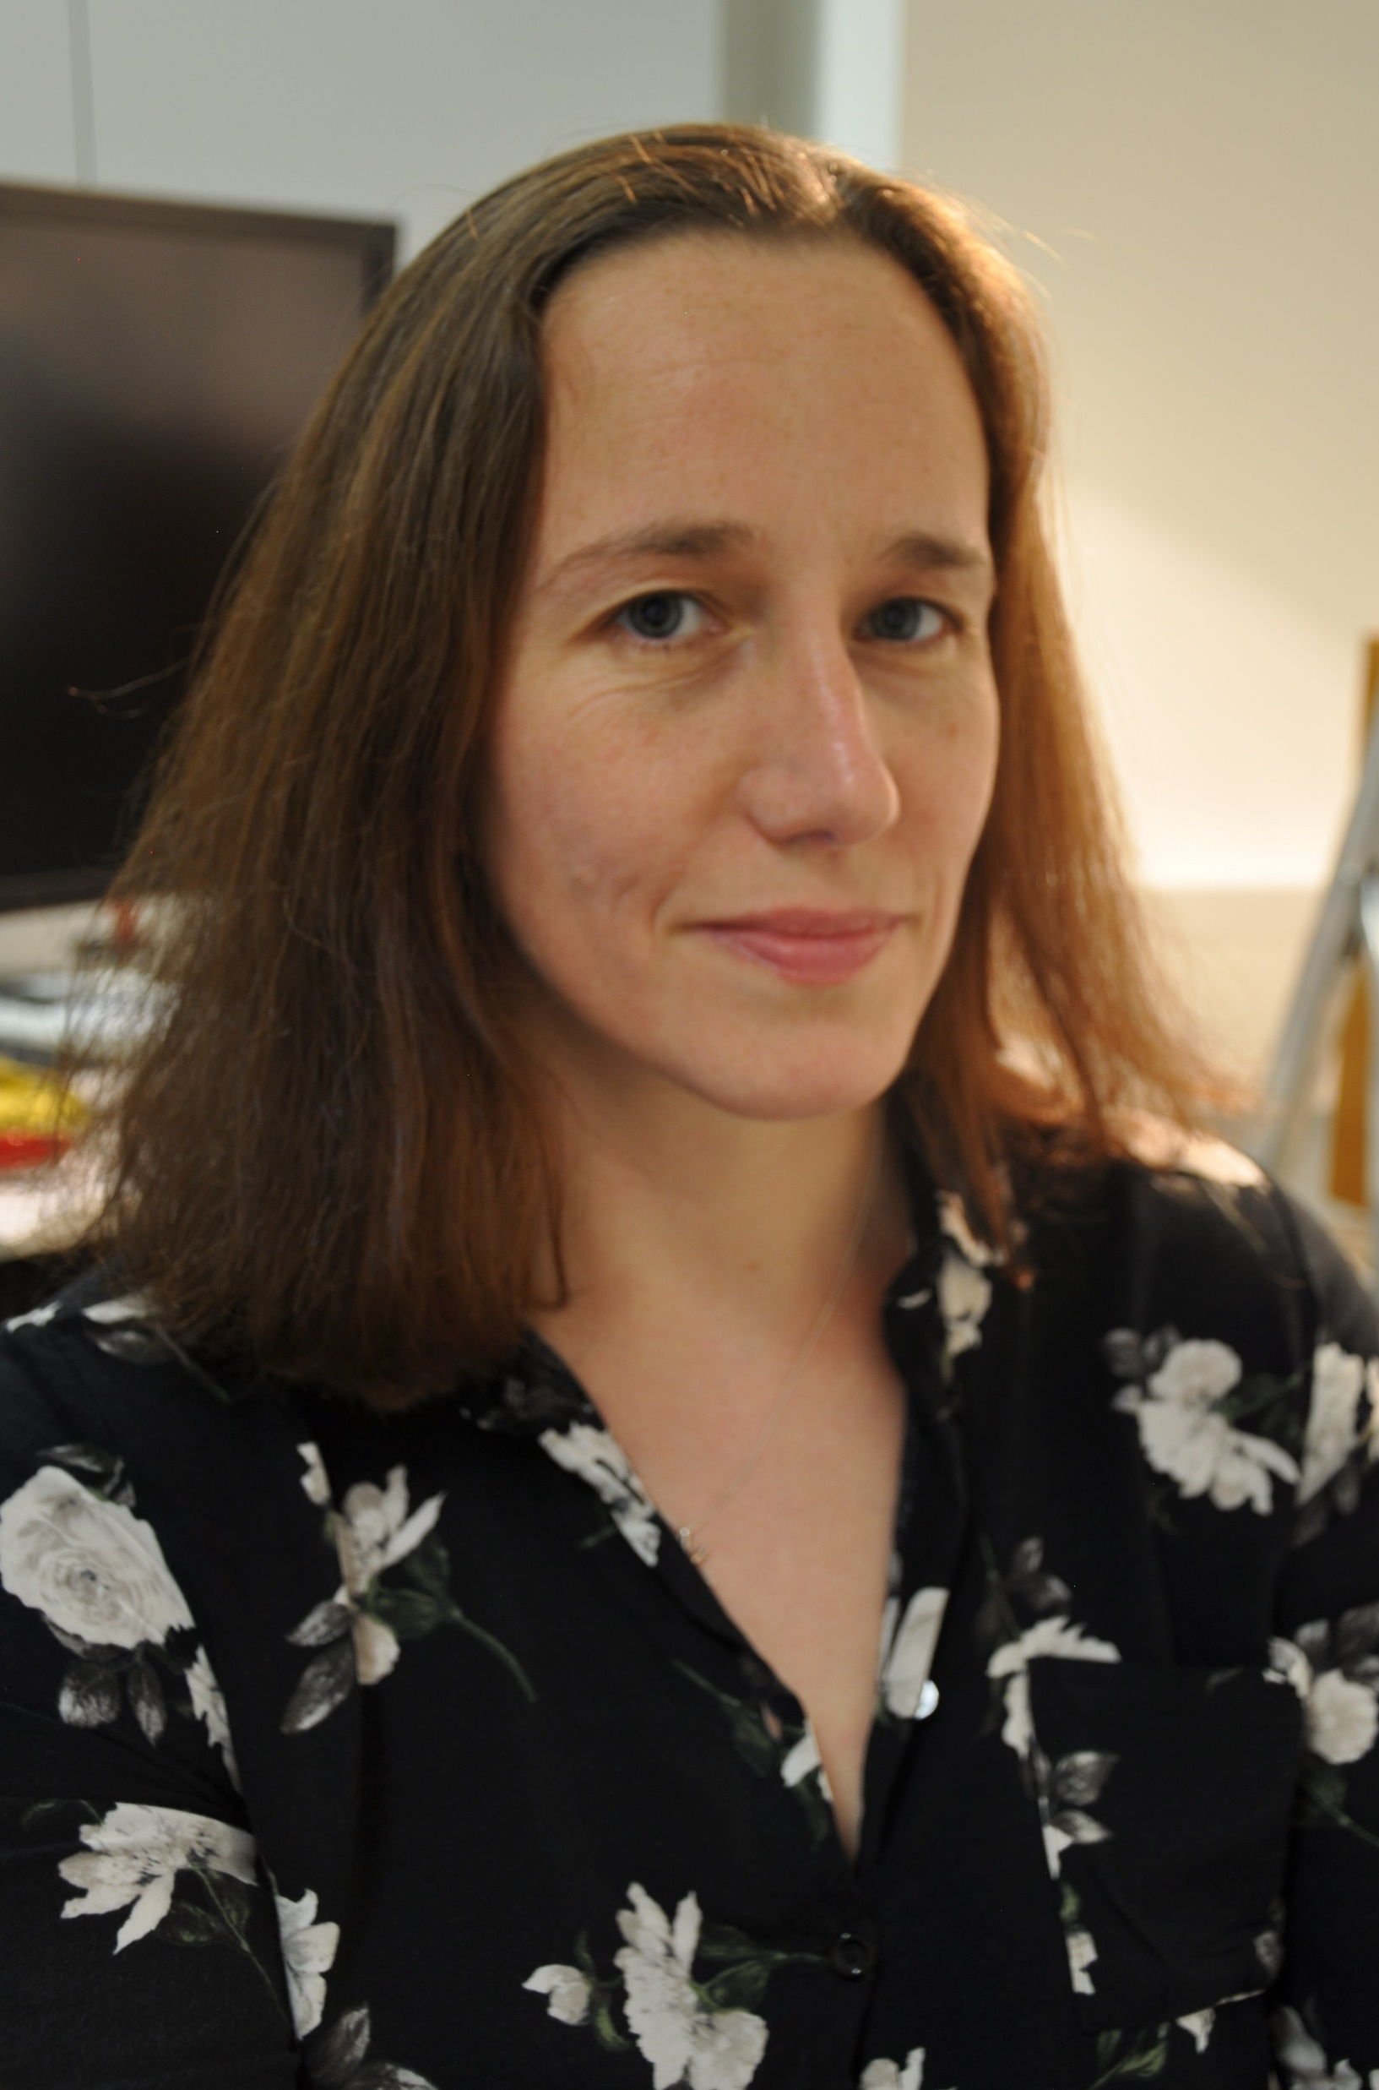
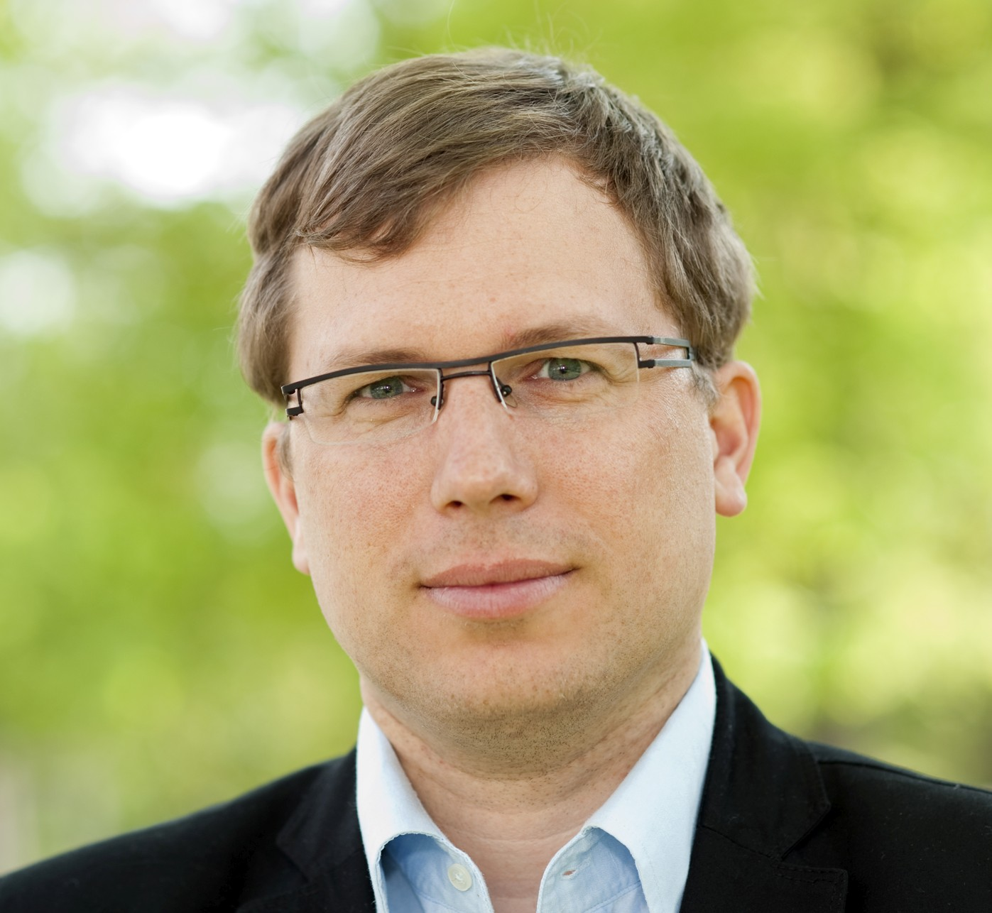
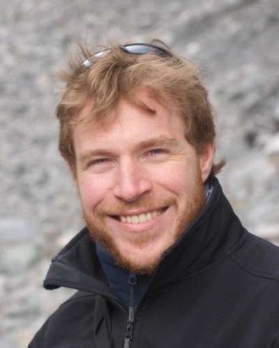
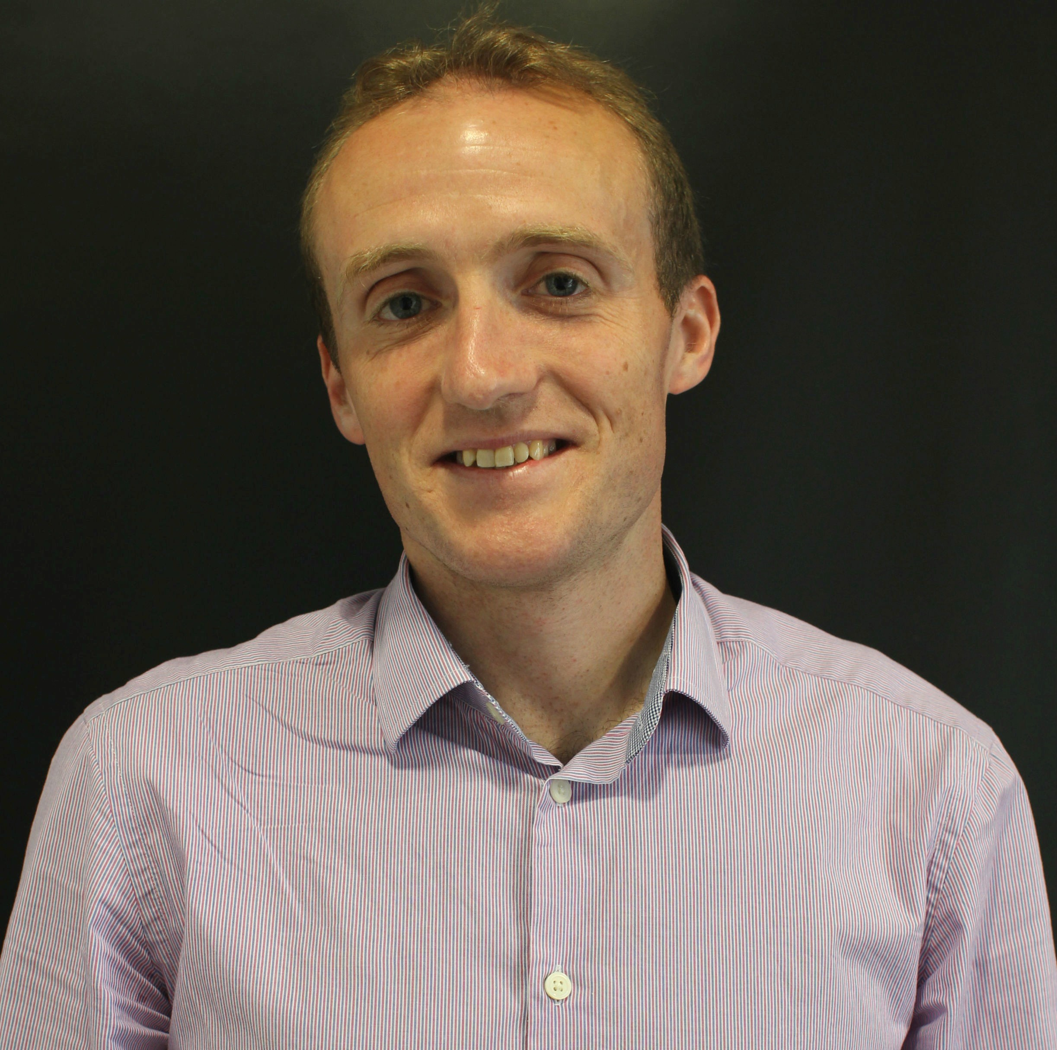
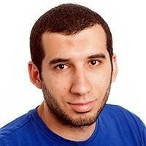
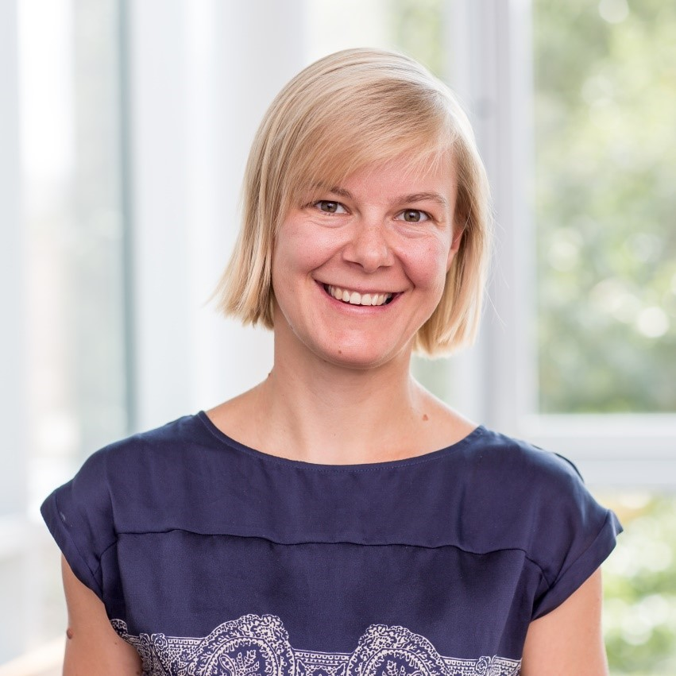
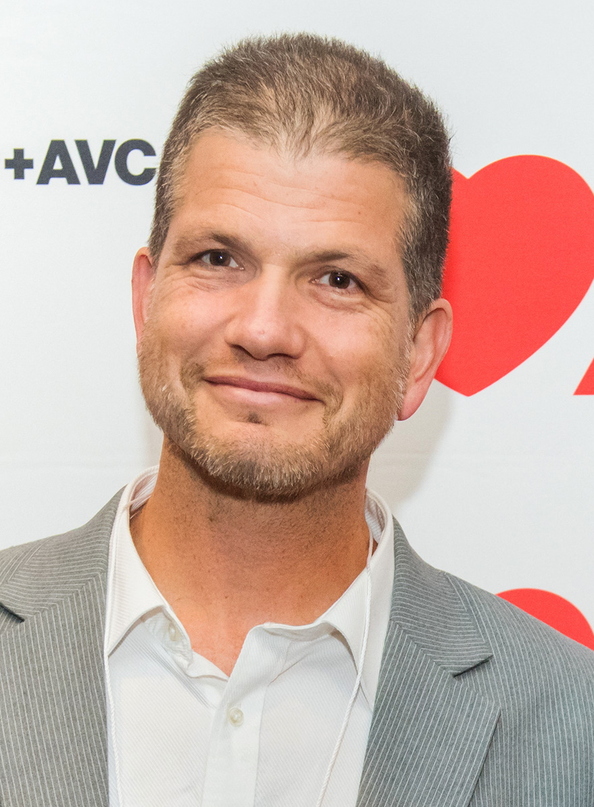
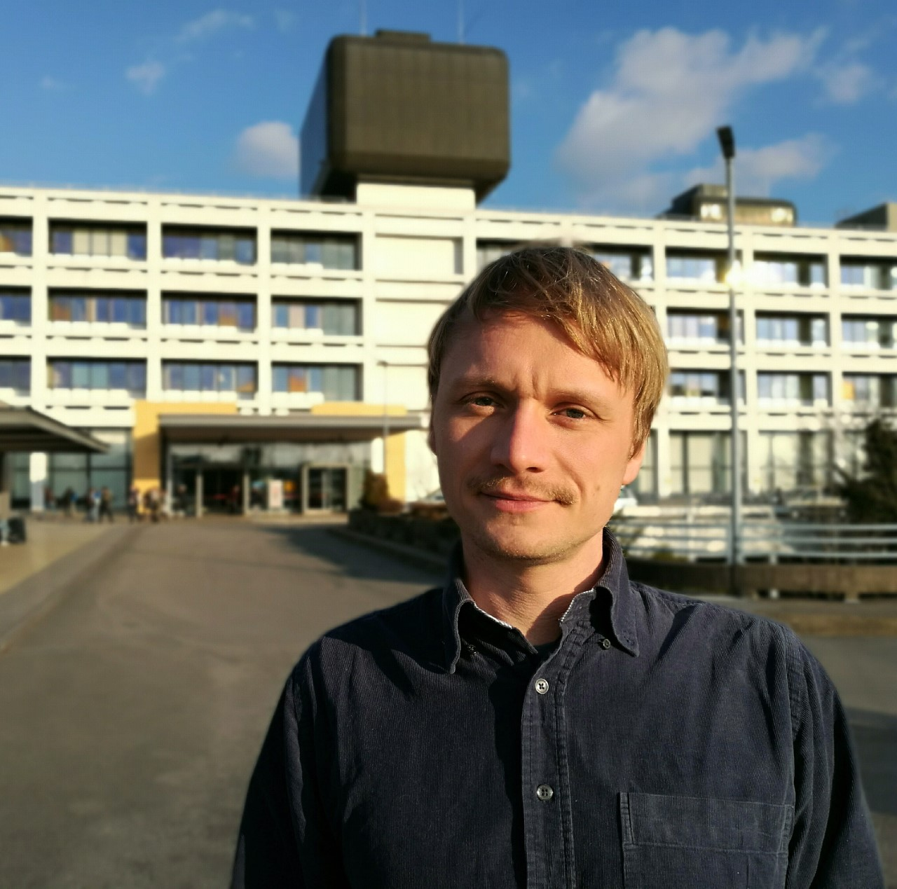

Chris Xu
Cornell University
Daniël Pijnapple
Hart Long
Leonardo Sacconi
LENS
Gail McConnell
Strathclyde University
Philipp Sasse
University of Bonn
Alex Corbett
University of Exeter
Martin Bishop
King’s College London
Ahmed Abdelfattah
Janelia
Franziska Schneider-Warme
Herzzentrum Freiburg
Gil Bub
McGill University
Jan Christoph
University Medical Centre Göttingen
Selected from abstracts

Slide 2
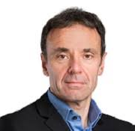
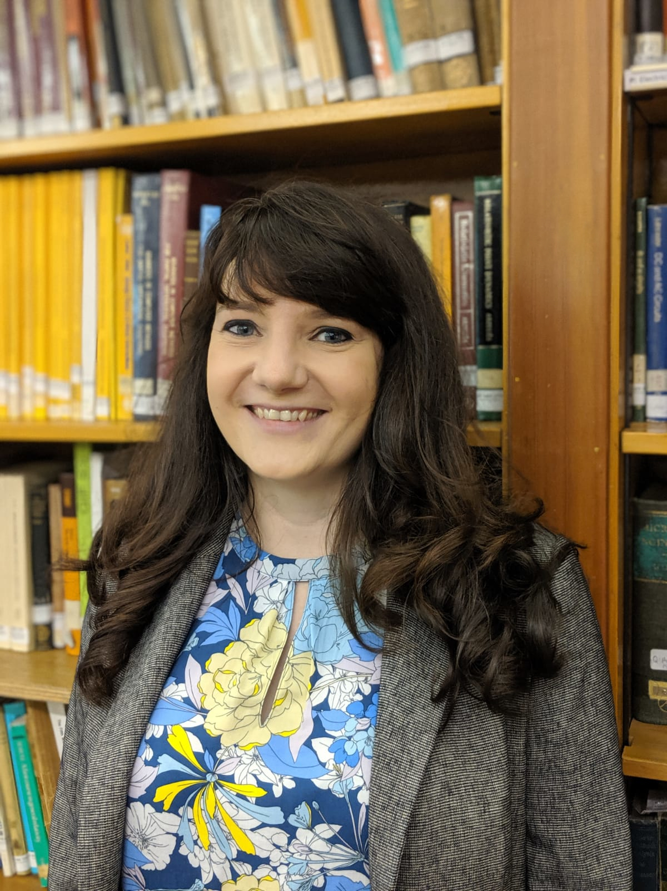
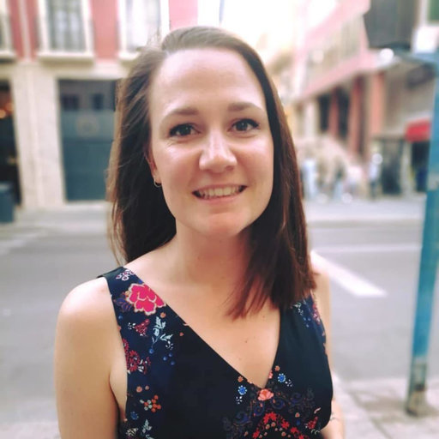
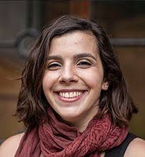
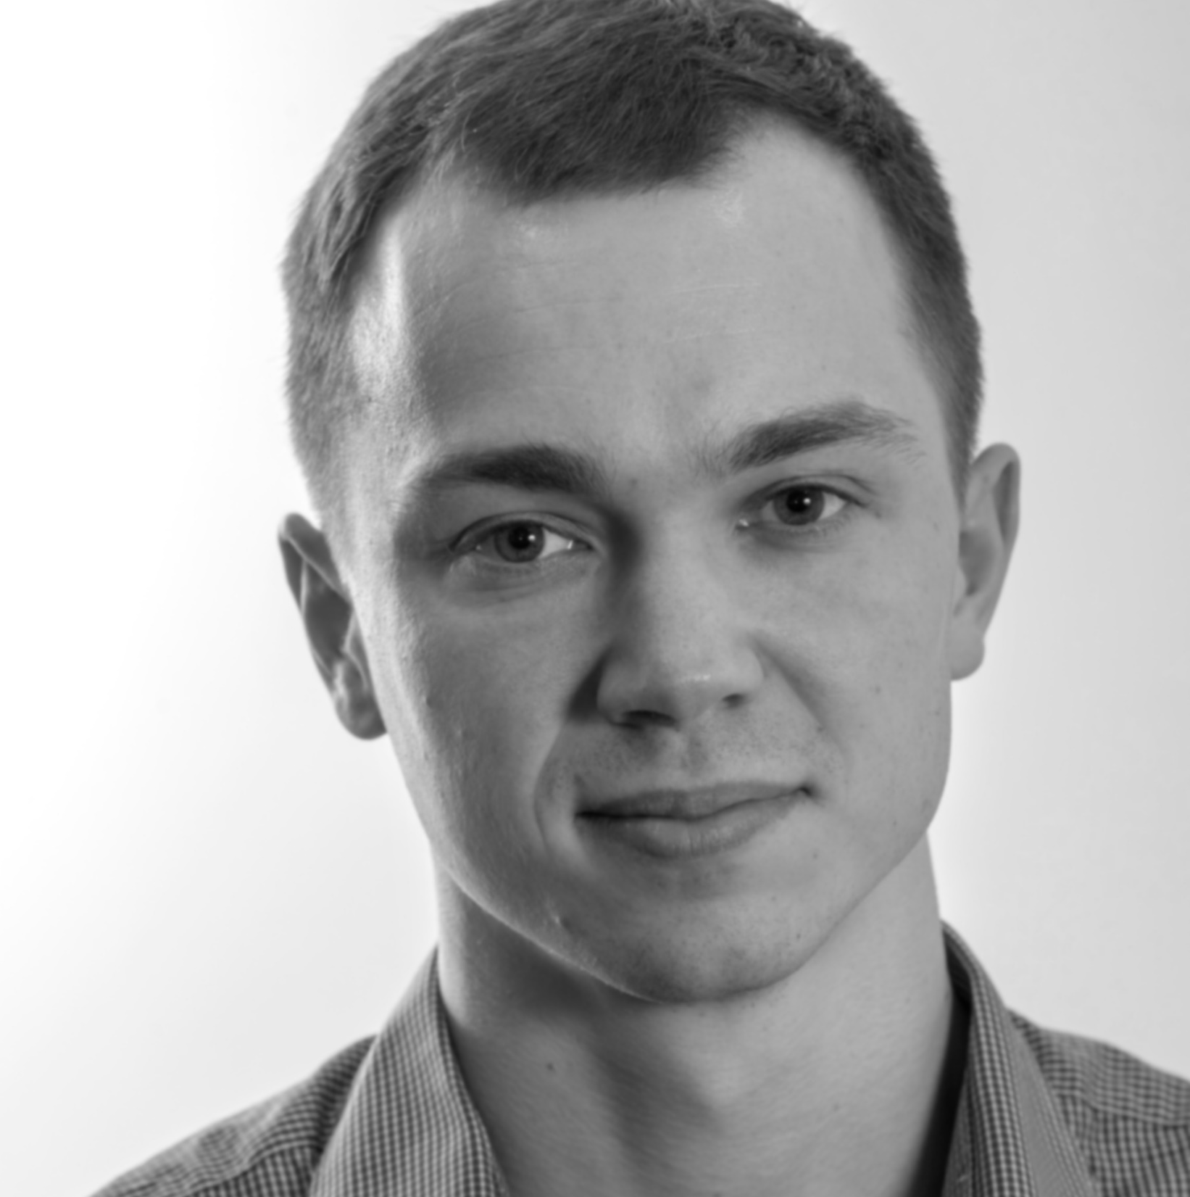
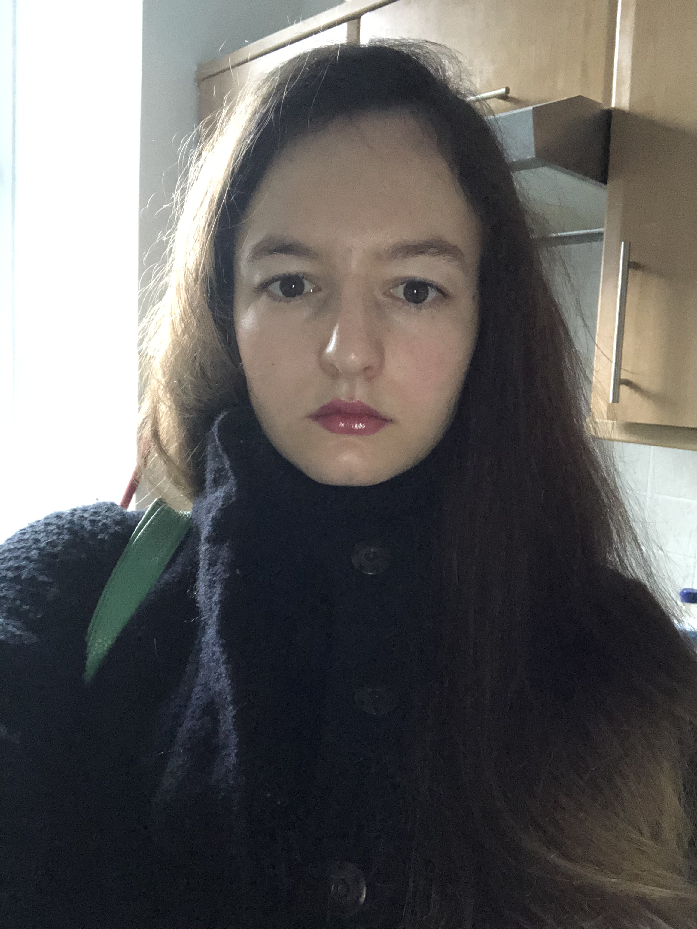
Leonardo Sacconi
Gil Bub
Godfrey Smith
Caroline Müllenbroich
Caroline Müllenbroich
Godfrey Smith
Eline Huethorst
Ana Costa
Vytautas Zickus
Lucrezia Cester

